Slide 1
ASSIGNMENT-1

Slide 2
Rules
There are 11(Shubh Mangal Zyada Saavdhan) questions in total.
Teams on direct and pass answer for +10/0
Teams can risk pounce for +10/-5
No part points on pounce
If no one can answer, teams can guess for fun.
No Partial marks in any question

Slide 3
Q1. Identify the Drink
Originating as a remedy concocted by a pharmacist in the late 19th century, this carbonated beverage emerged from Atlanta, Georgia, in 1886. Its secret formula, guarded under lock and key, features a unique blend of spices and a distinct syrup, giving it an unparalleled taste. Initially marketed as a medicinal tonic, this fizzy elixir quickly gained popularity for its refreshing qualities and effervescence. With its iconic red and white logo, it has become a global symbol of unity and enjoyment, featured prominently in popular culture and celebrations worldwide. Renowned for its presence in movies, advertisements, and festive occasions, this beverage is more than just a drink; it's a cherished emblem of shared moments and joyous gatherings. What is the name of this beloved soft drink, synonymous with happiness and global connections?

Slide 4


Slide 5
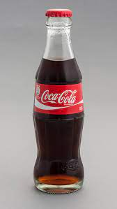

Coco-Cola

Slide 6
Q2. Guess the city
This city, steeped in history and culture, holds a unique distinction in India. It has served as the capital of several empires, witnessed the rise and fall of dynasties, and experienced countless conquests throughout its existence. With its strategic location along ancient trade routes, it emerged as a center of commerce and power, attracting rulers and traders from far and wide. Despite facing numerous invasions and upheavals, it has resiliently stood the test of time, evolving into a dynamic metropolis that seamlessly blends tradition with modernity. From the majestic ruins of ancient fortifications to the bustling markets of its vibrant neighborhoods, this city is a living testament to the passage of time and the resilience of its people. Known by various names throughout history, including its ancient Sanskrit name meaning "city of cities," what is the name of this historic city iofIndia?

Slide 8
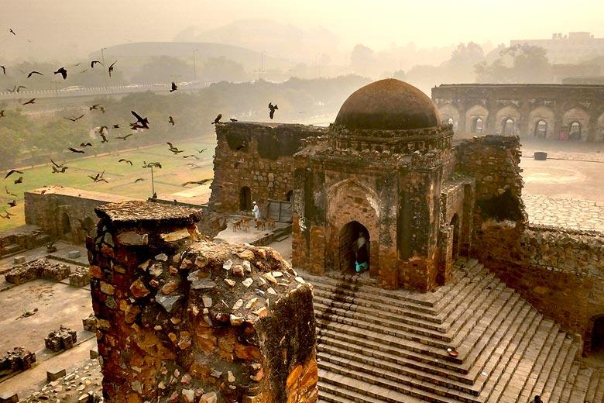
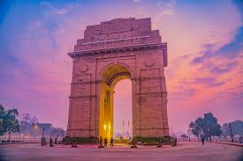
Delhi

Slide 9
Q3. Identify the Leader.
This formidable historical figure, born in 1769 on the island of Corsica, left an indelible mark on the course of European history. Rising from obscurity, he navigated the treacherous political landscape of post-revolutionary France to become a military prodigy and statesman. His strategic brilliance was evident in decisive victories like Austerlitz, yet his ambitions knew no bounds. In 1804, he transformed the political landscape by declaring himself Emperor, ushering in a new era. However, his grand aspirations led to a series of military misfortunes, culminating in his defeat at Waterloo in 1815. Exiled to a remote island, he lived out his days in captivity, leaving a legacy that continues to fascinate and polarize historians. Revered as a military genius and reviled as a power-hungry despot, who is this complex and influential figure from the annals of history?

Slide 11
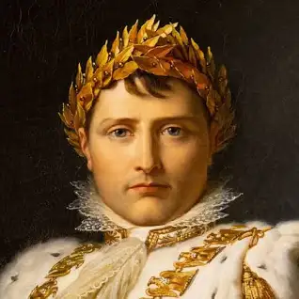
Napoleon Bonaparte

Slide 12
Q4. Identify connection
In the tapestry of Christmas traditions, my name, Krishna :)), weaves a unique thread connecting the festive season with a diverse cultural resonance. While traditionally associated with Hindu mythology and the divine, Krishna takes on a distinctive role in the global celebration of Christmas. One might find an intriguing connection in a famous literary work where the protagonist, named Krishna, embarks on a magical journey during the Christmas season. This narrative, blending Eastern and Western influences, creates a fascinating intersection between your name and the Christmas spirit. Can you unravel this enigmatic connection by identifying the literary work and its author, where a character named Krishna embarks on a Christmas-themed adventure?

Slide 14
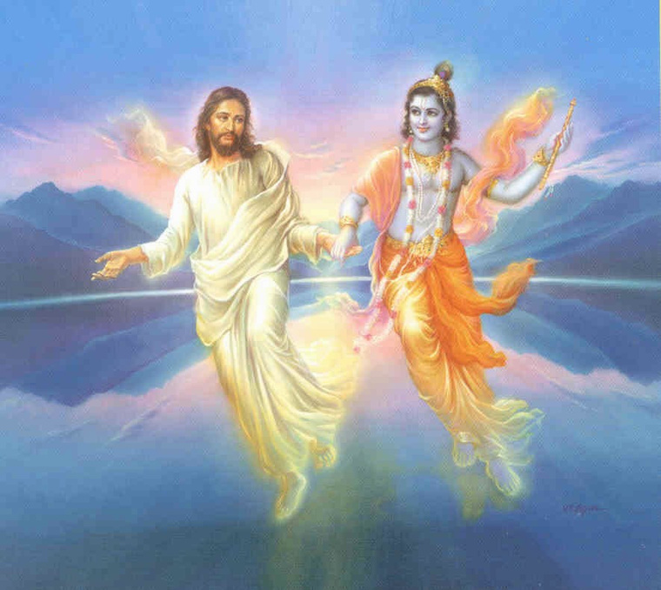
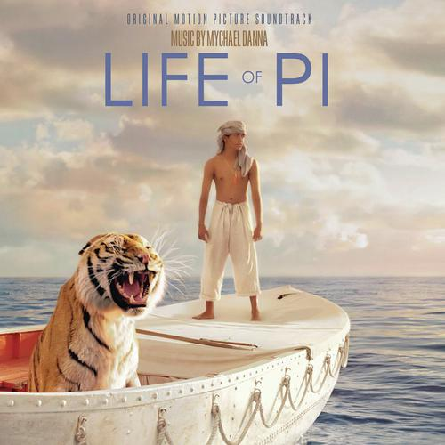

Slide 15
Q.5 Guess the Snack
In the realm of digital logic, an elementary yet crucial component serves as a fundamental building block for computational circuits. This component, known for its binary logic operations, acts as a gatekeeper, allowing signals to pass through only when certain conditions are met. Interestingly, a popular snack shares its name with this logic gate, embodying a unique fusion of sweet indulgence and technological innovation. What is the name of this logic gate that shares its name with a beloved sandwich cookie, renowned for its distinctive black-and-white layers and satisfying crunch?

Slide 17
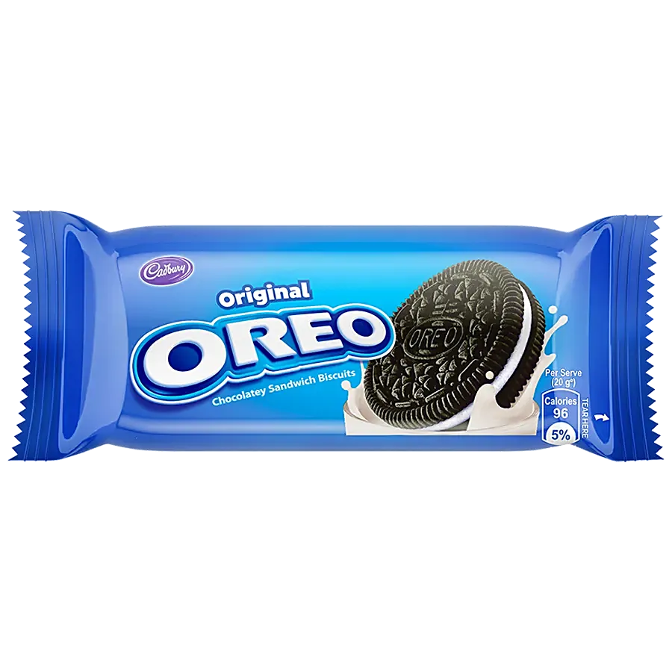
Oreo(OR gate)

Slide 18
Q6. LOL IDK The Ans
Deep within the fabric of everyday communication lies a mysterious entity, often overlooked yet ever-present in our linguistic tapestry. It's the secret language of the streets, the vibrant jargon of subcultures, and the colorful expressions that defy conventional grammar rules. Born from the depths of human interaction, it evolves with each passing generation, weaving its way into the vernacular of the masses. What single word encapsulates this rich, ever-changing lexicon of informal and unconventional expressions, embodying the essence of cultural identity and linguistic diversity?

Slide 20
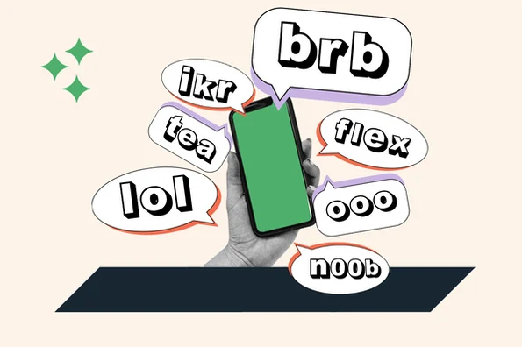
Slang

Slide 21

Navigating the labyrinthine corridors of scientific inquiry, one encounters a discipline that unearths the enigmas of matter and energy, employing meticulous experimentation and theoretical prowess. Concurrently, within the linguistic fabric of Hindi, a word resonates with artisanal mastery and skillful craftsmanship. Can you uncover this cryptic term that binds the realms of scientific exploration and traditional expertise, embodying the essence of both scholarly inquiry and skilled craftsmanship?
Q7.

Slide 23


The photo attached was of (C)yrus (Mistry).

Slide 24
Q8.
Entwined within the fabric of daily wear lies a garment revered for its functionality and ubiquity, adorning individuals in various forms across cultures and eras. This article of clothing, characterized by its separate leg coverings and waistband, is xan indispensable part of everyday attire. Conversely, within the digital sphere, there exists a term denoting individuals who engage with software platforms, systems, or online interfaces. Can you unveil this elusive term that binds the realm of clothing with the digital domain, signifying both sartorial necessity and digital interaction?

Slide 26

Trousers(users)

Slide 27
In the vast expanse of the heavens, where clouds dance and stars shimmer, there exists a boundless expanse of blue that stretches as far as the eye can see. This celestial canvas, known for its ever-changing hues and infinite vistas, has inspired awe and wonder in humanity since time immemorial. Conversely, in the world of distilled spirits, there's a beverage renowned for its amber hue and complex flavors, crafted through the meticulous blending and aging of grains. Can you identify this term that parallels the expanse of the sky, embodying both the vastness of the heavens and the richness of distilled spirits?
Q9.

Slide 29
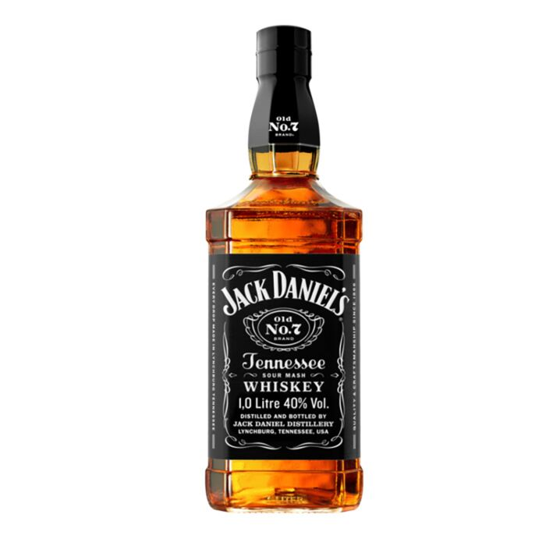
Whiskey

Slide 30
Q10.
In the realm of colors and design, there exists a standardized system that categorizes and identifies hues with precision and consistency. This system, utilized by artists, designers, and manufacturers worldwide, assigns unique codes to each shade, ensuring accurate reproduction and communication of color across various mediums. Conversely, in the realm of financial documentation and identity verification, there's a crucial document issued by governmental authorities to residents for taxation and financial transactions. Can you identify this term that bridges the world of colors and design with the realm of financial identity, embodying both the spectrum of hues and the formal documentation of financial affairs?

Slide 32
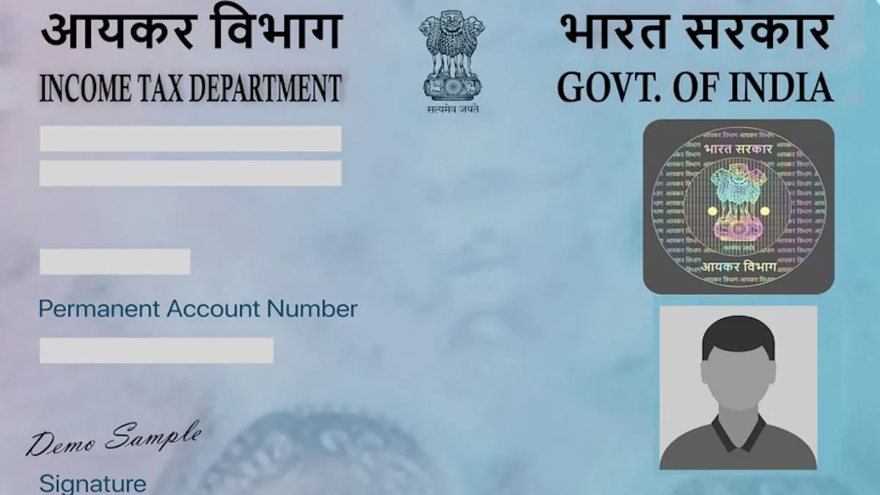

Pantone

Slide 33
Q.11. What am I describing?
Within the realm of culinary experiences, there exists a sumptuous delicacy that epitomizes richness and comfort, often adorned with toppings or sauces to enhance its allure. This culinary masterpiece, enjoyed in various forms across cultures, captivates palates with its decadent flavors and luxurious texture. Conversely, in the realm of auditory sensations, there's a distinct and resonant sound that echoes through the air, drawing attention and signaling a moment of significance. Can you identify the term that intertwines the world of gastronomic delights with the resonant sound, embodying both the richness of a gourmet dish and the distinct ding of an alert?

Slide 35
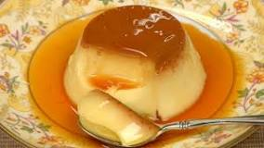
Pudding (Ding)

